Slide 1
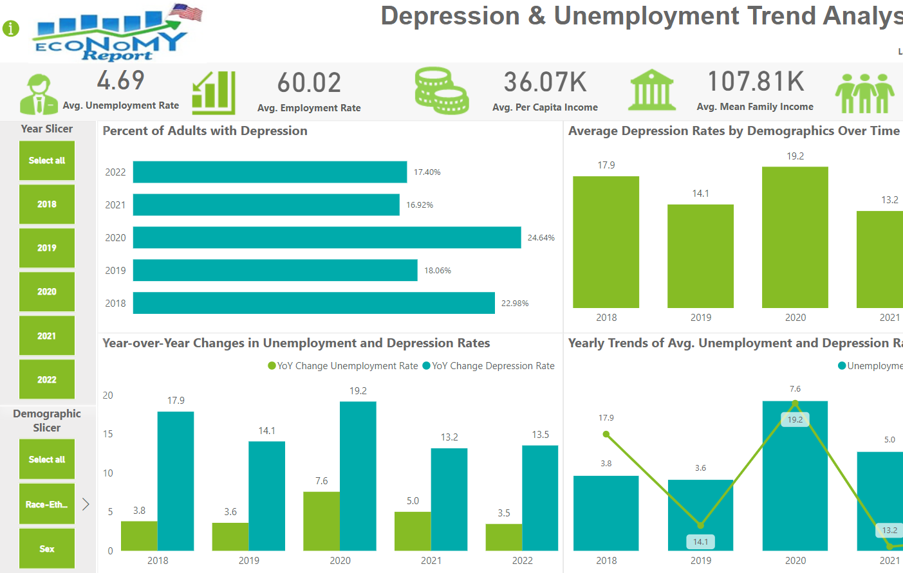
Step 1: “Tab1: Depression & Unemployment Analysis” has Information Icon Button. As we click on that it will take us to the hidden Overview Tab of the Scorecard.

Slide 2

Step 2:Overview Tab has the Back button to take us back to the previous Tab where we were present last.

Slide 3
Step 3: As we click on the hyperlinked Impact of Unemployment in Mental Health it will take us to the user guide on how to navigate through the Scorecard.

Slide 4
Step 4: For the entire Tab 1 filtering. It can, be done through Slicers Panel.
Choose your desired criteria.

Slide 5
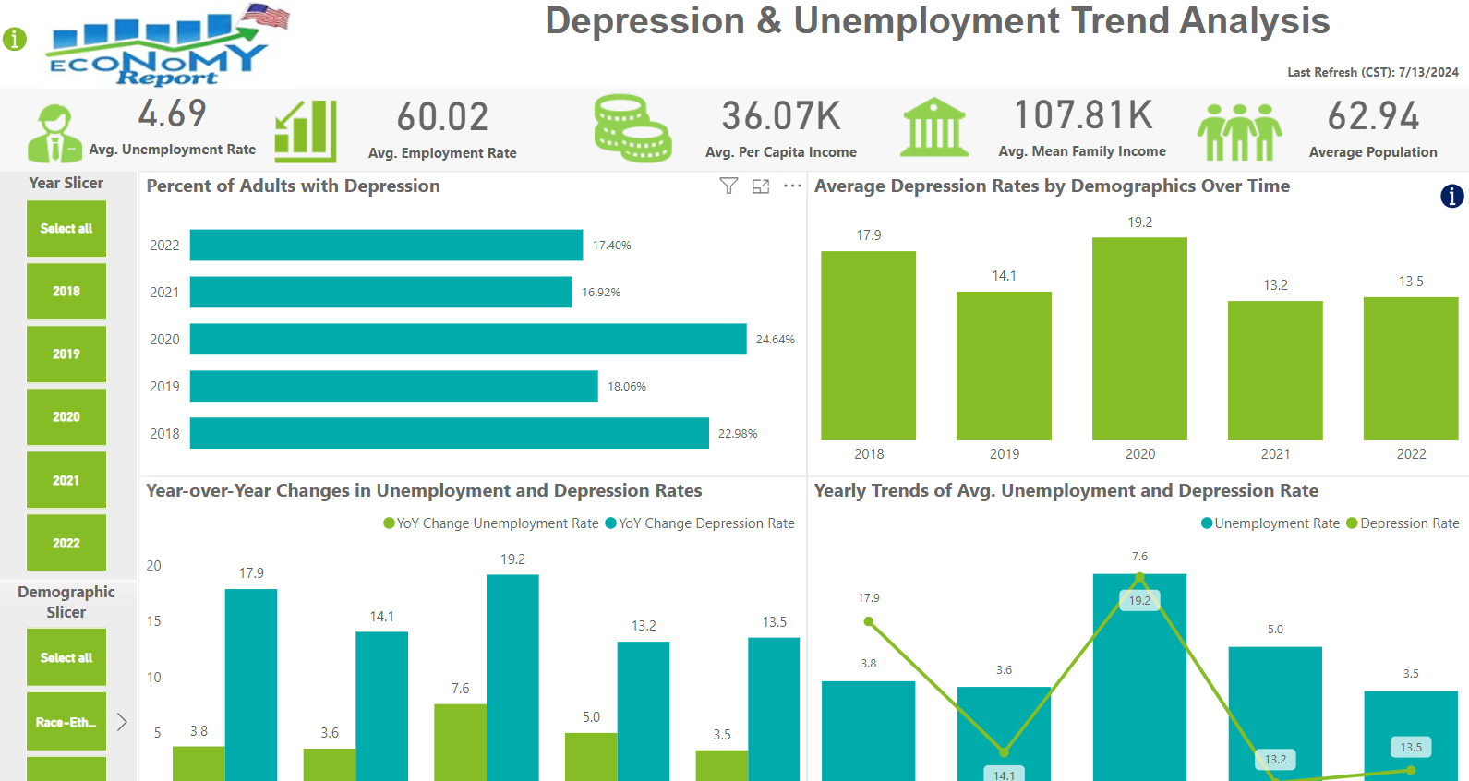
Step 5: “Tab1: Depression & Unemployment Analysis” we are showing 5 KPI’s. These KPI’s reflect the crucial Values of the Business.

Slide 6
Step 6: “Tab1: Depression & Unemployment Analysis” this is a Drill Down chart please read the Tool Tip is Blue Color to understand how to use the visual.

Slide 7
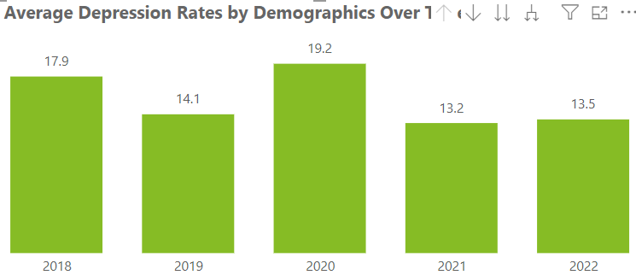
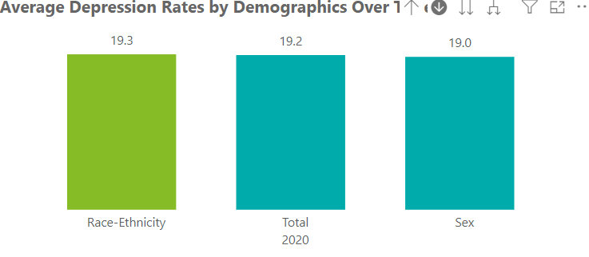
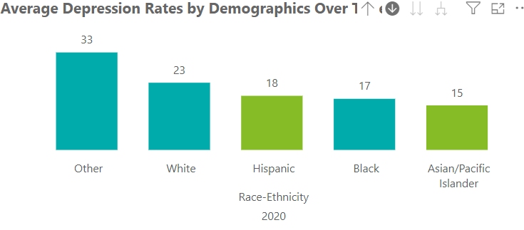
Step 6: Click on the button highlighted to activate Drill Down. And click on one of the Bar.
Step 7: Again, click on one of the Bar to see data by Demographics Category
Step 8: Again, click on one of the Bar to see data through “Sex”, “Race” “Ethnicity or Total”

Slide 8
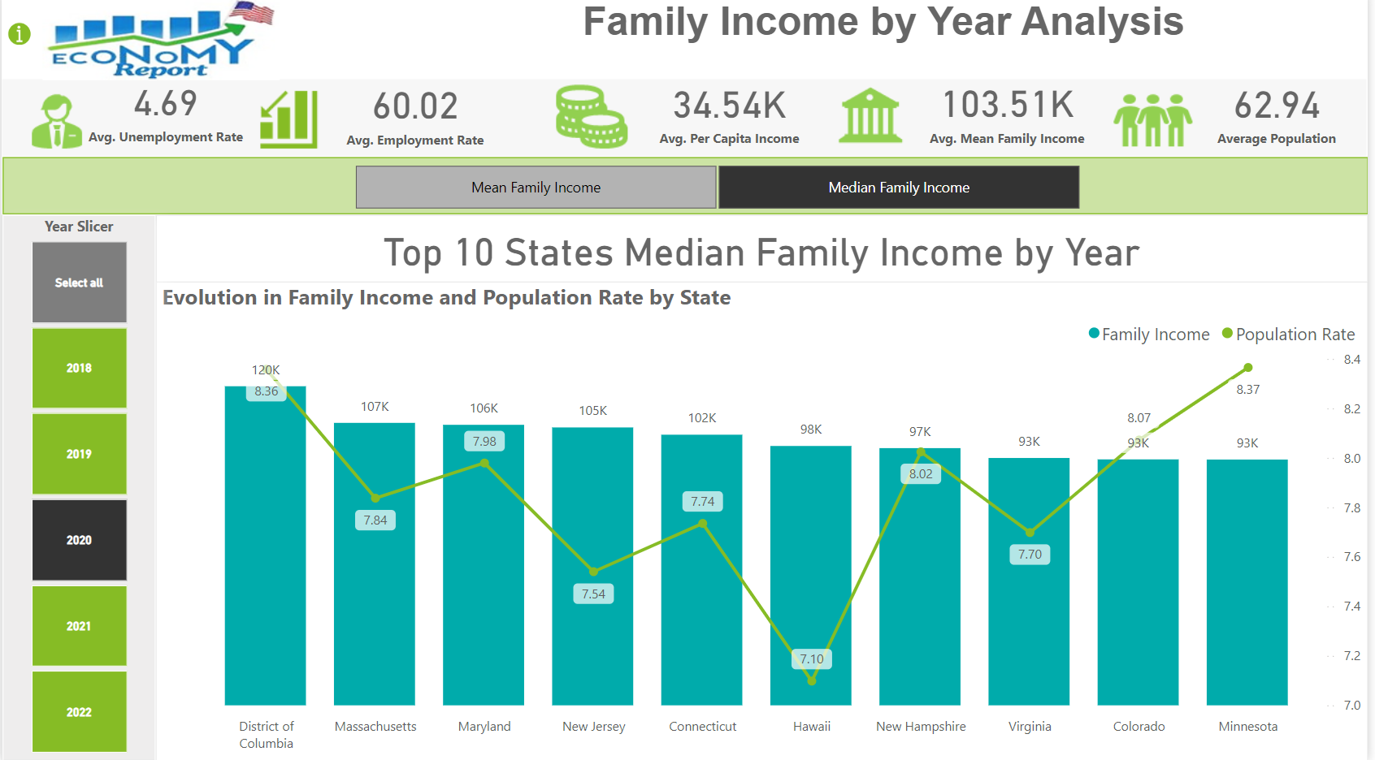
Step 9: “Tab2: Family Income by Year Analysis ” on the Visual of TOP 10 States Median Family Income by Year we are passing the parameter values to visual and with the help of tile button (Parameters) we are doing the instantaneous slicing and dicing by “Mean Family Income” and “Median Family Income”

Slide 9
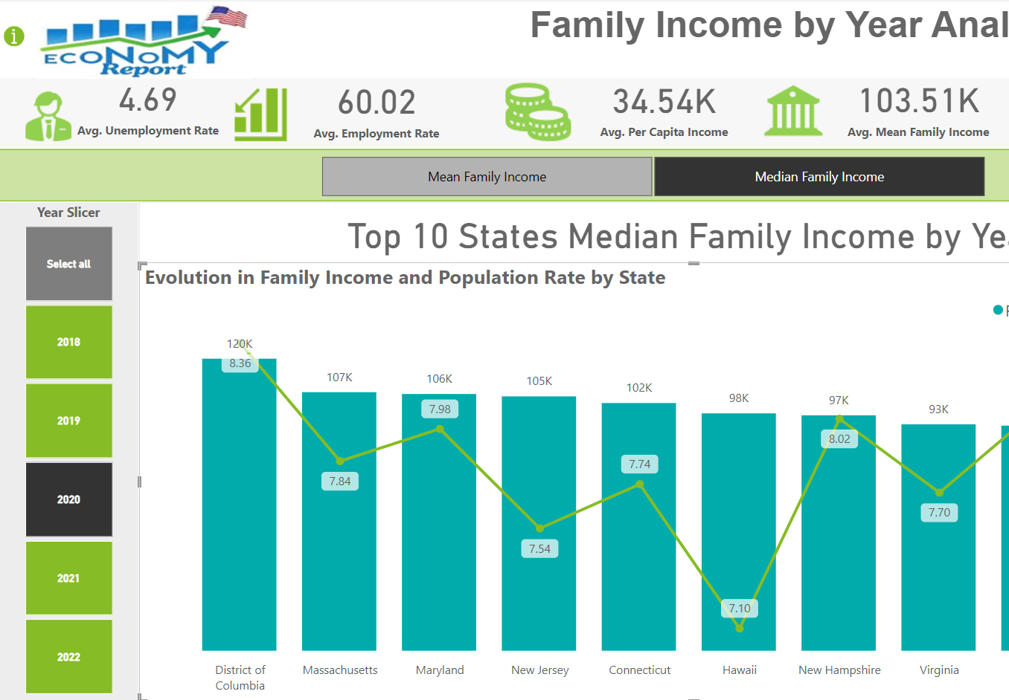
Step 10: For the entire Tab 2 filtering. It can, be done through Slicers Panel.
Choose your desired criteria.

Slide 10
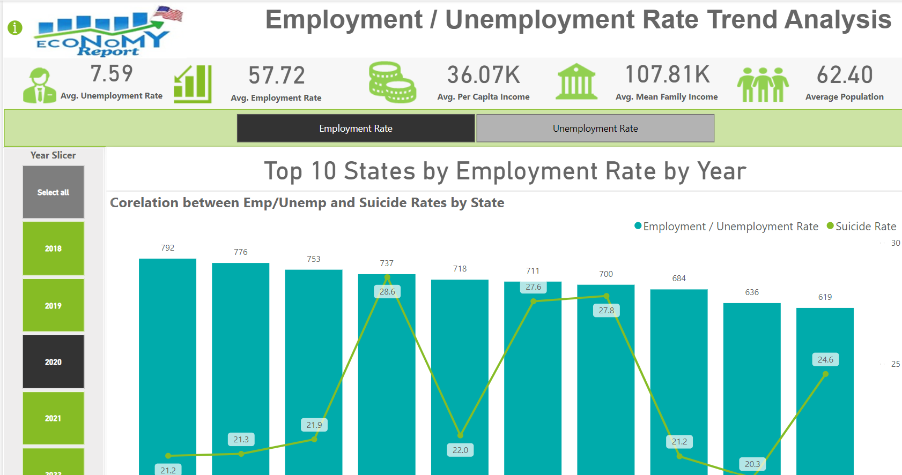
Step11:“Tab3:Unemployment/Unemployment by Year Insights” on the Visual of Tab3:Unemployment/Unemployment by Year Insights by Year we are passing the parameter values to visual and with help of tile button (Parameters) we are doing the instantaneous slicing and dicing by “Employment Rate” and “Unemployment Rate”

Slide 11
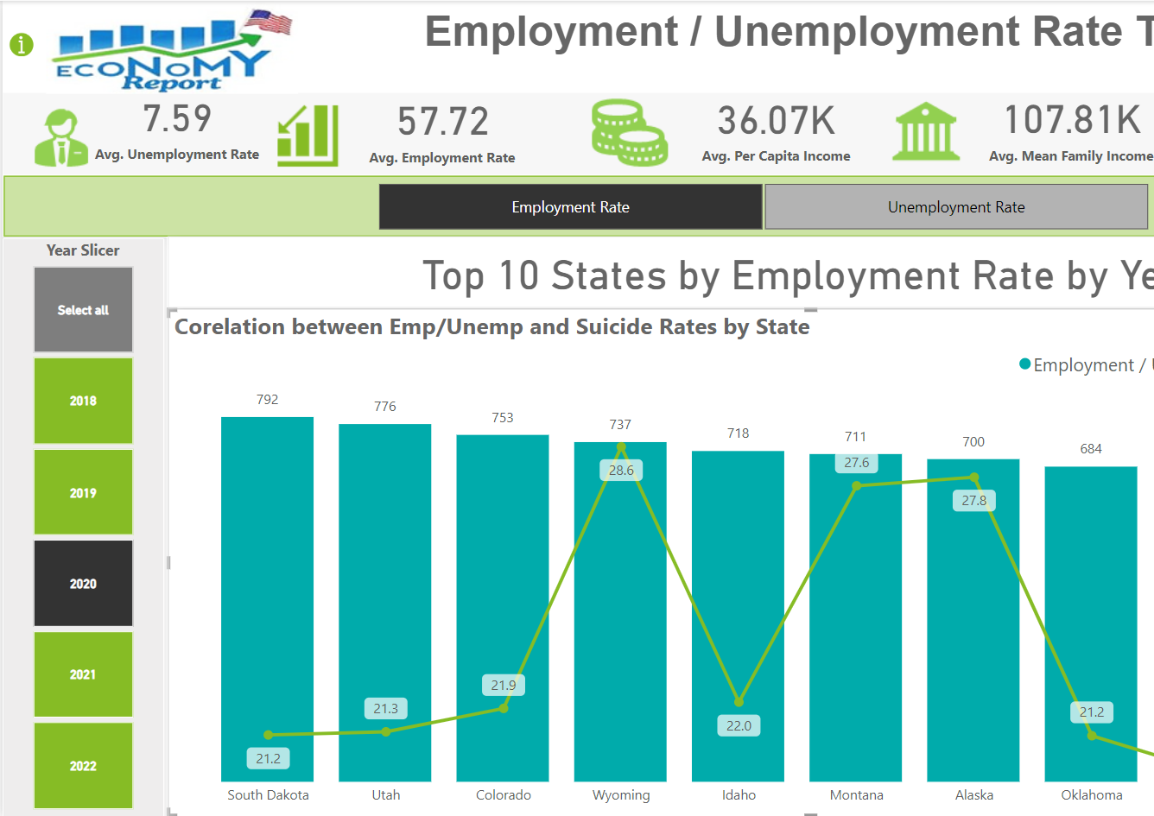
Step 12: For the entire Tab 3 filtering. It can, be done through Slicers Panel.
Choose your desired criteria.

Slide 12
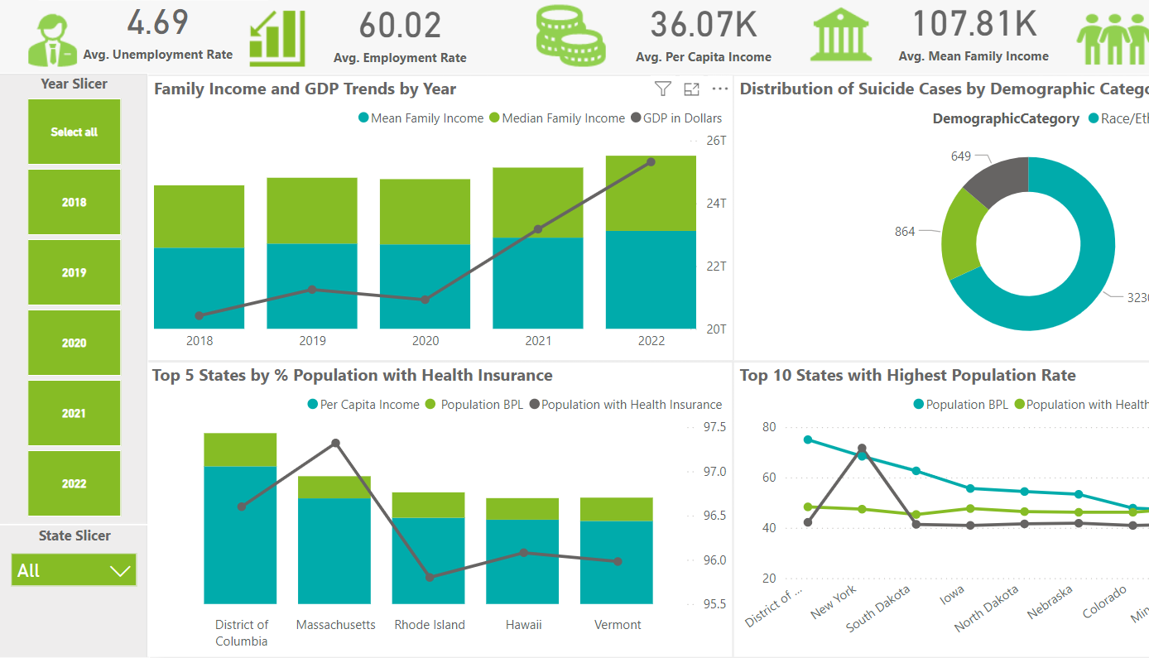
Step 13: For the entire Tab 4 filtering. It can, be done through Slicers Panel.
Choose your desired criteria.
Step 14: This visual has the Drill Down and Drill through functionality. The Blue Button has the info on how to use that Chart.

Slide 13
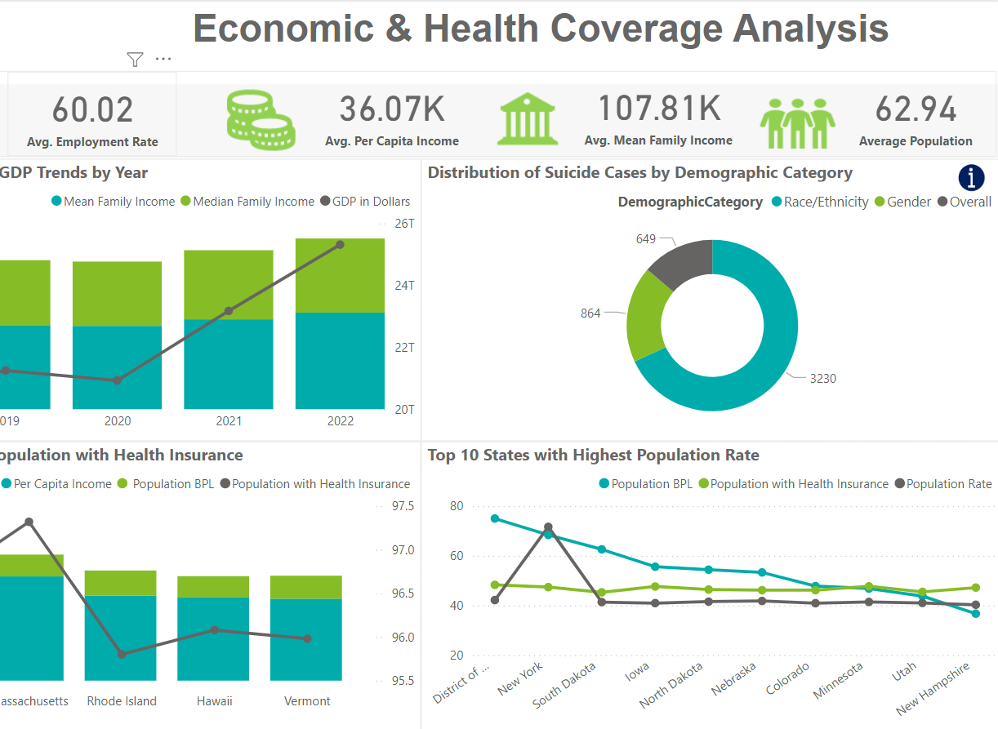
Step 14: This visual has the Drill Down and Drill through functionality. The Blue Button has the info on how to use that Chart.

Slide 14
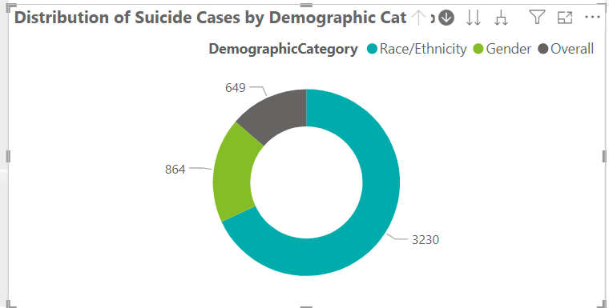
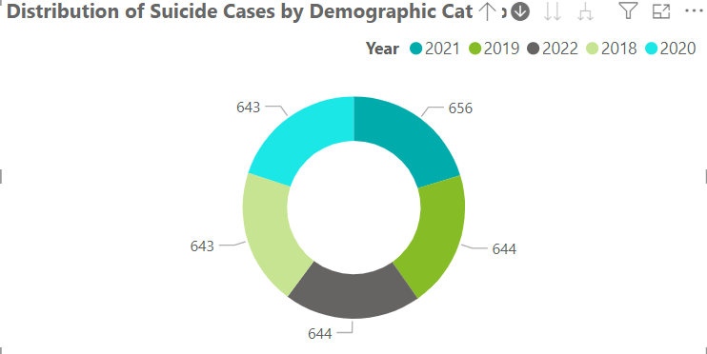
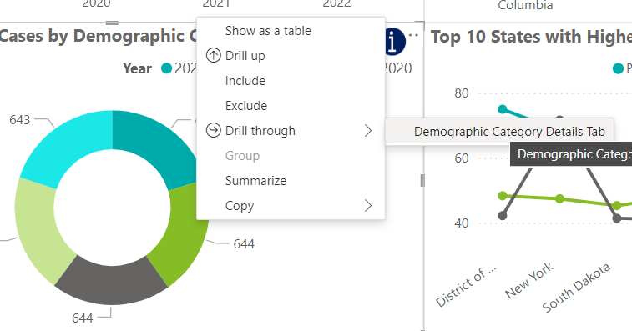
Step 15: Click on the button highlighted to activate Drill Down. And click on one of the Slice.
Step 16: Once we click on one of the Slice it will start showing selected Demographic Category by Year Slices.
Step 17: Right Click on one of the slices to Drill Through to the “Demographic Category Details Tab”

Slide 15
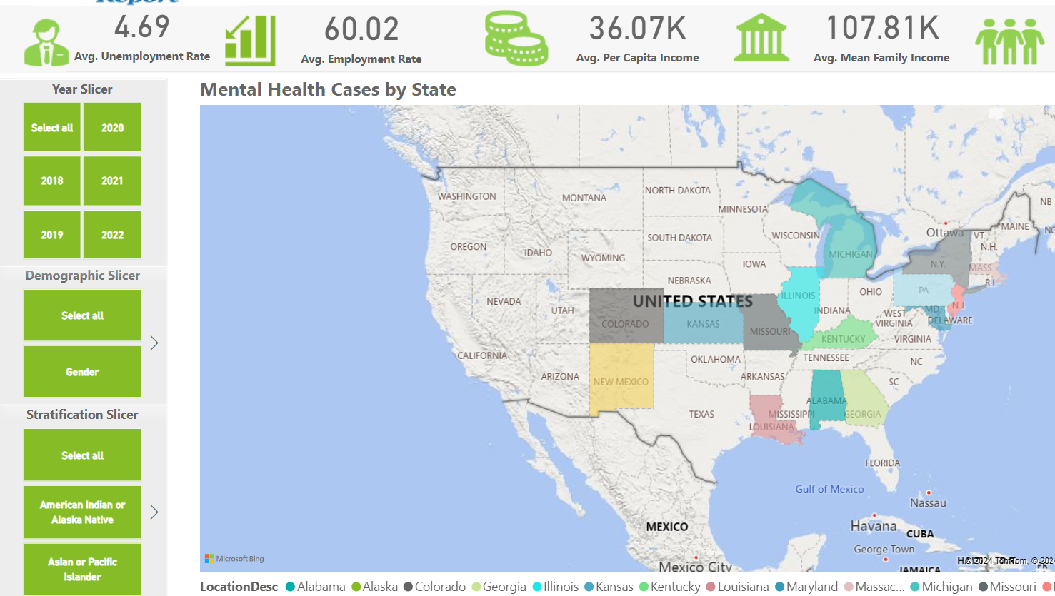
Step 18: For the entire Tab 5 filtering. It can, be done through Slicers Panel.
Choose your desired criteria.

Slide 16
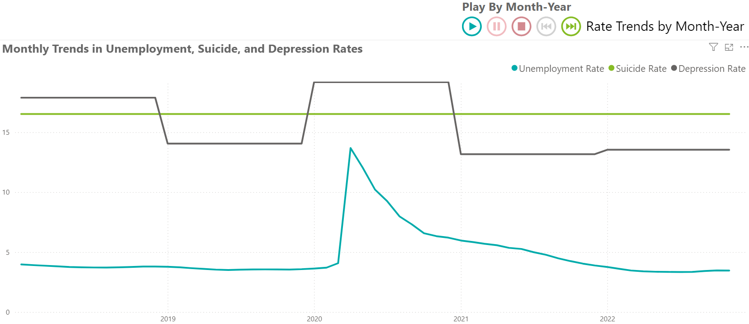
Step 19: Operate the Animated Visual on Tab : “Tab6: Animated Visualization of Rates” with these buttons.

Slide 17
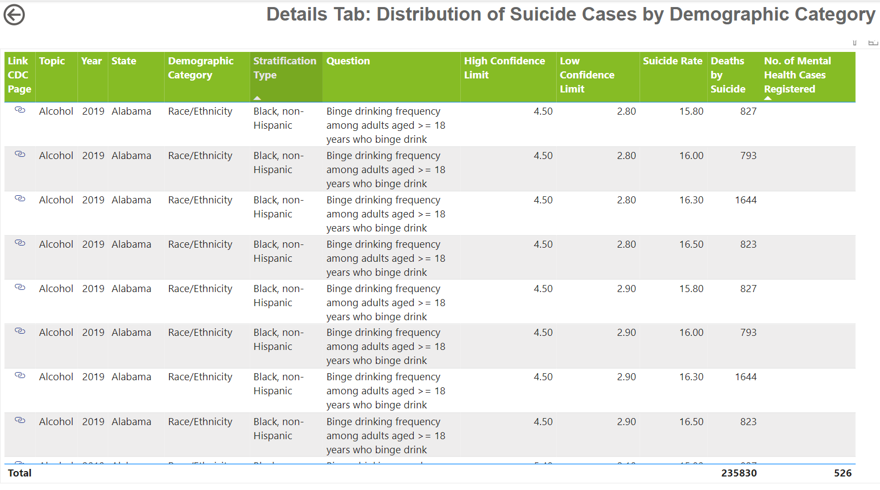
Step 20: There is a Hidden tab in the Report called, “Demographic Category Details Tab ” after the Drill Through we can go to the previous Tab with Back button.

Slide 18
THE END

